Slide 1
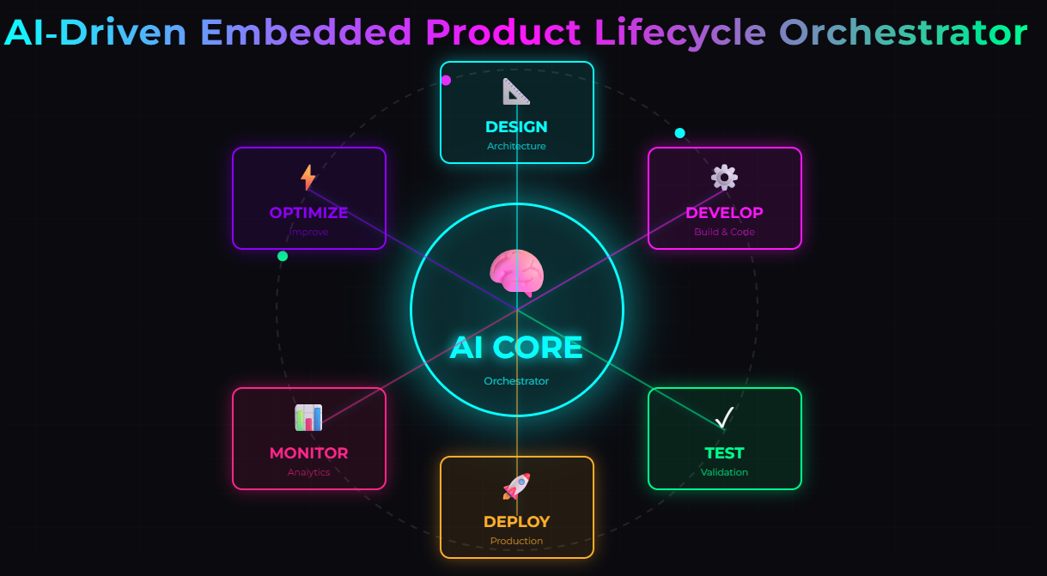
End‑to‑End Embedded Intelligence | Faster | Safer | Predictable
Notes:
Today, we present an AI‑Driven Embedded Product Lifecycle Orchestrator.
Our solution unifies development, QA, and release into a single intelligent pipeline, improving speed, quality, and predictability.

Slide 2
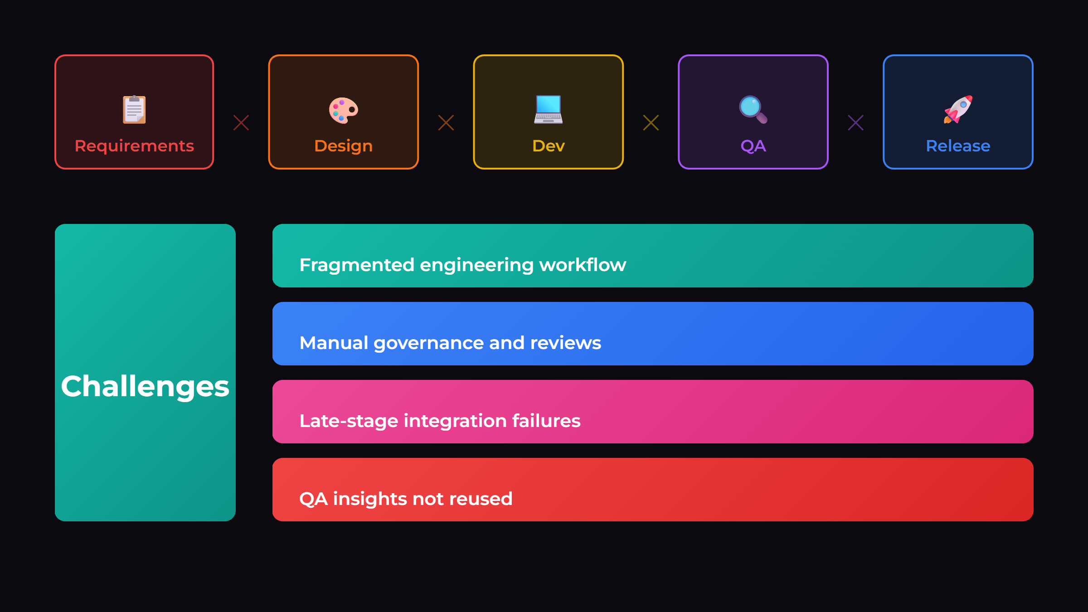
Notes:
Embedded development is highly fragmented.
Lifecycle stages operate in silos, leading to late defect discovery, manual governance overhead, and limited reuse of QA insights.

Slide 3
Solution
Lifecycle-aware AI orchestrator
Multi-agent engineering intelligence
Continuous QA feedback loop
Governance built-in
Notes:
We introduce a lifecycle-aware AI orchestrator that coordinates development, validation, and release using specialized agents.
It integrates engineering data, applies governance continuously, and enables learning from QA to improve future releases.

Slide 4
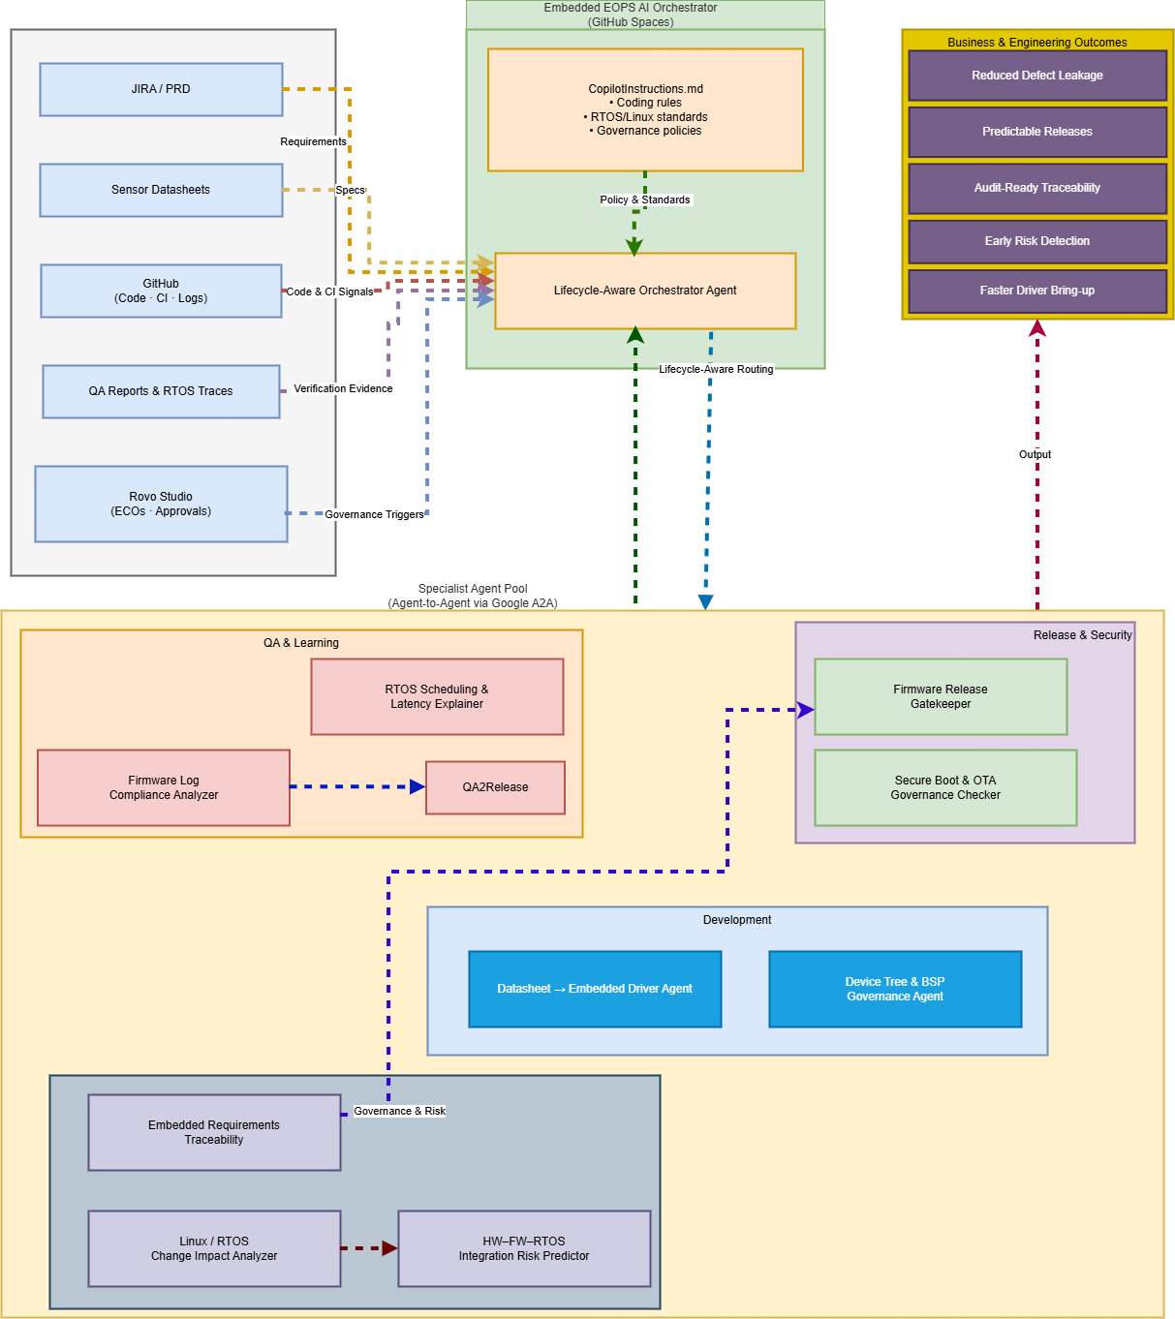
Architecture (EOPS Copilot)
Notes:
This architecture connects inputs such as requirements, code, QA results, and governance rules.
The orchestrator routes tasks across specialized agents, ensuring continuous validation and decision-making across the lifecycle.

Slide 5
Change Impact Analysis
Detect
Detect RTOS & config changes
Analyze
Analyze scheduling and timing impacts
Flag
Flag system-level risks early
Notes:
The system analyzes engineering changes in real time and identifies potential risks such as timing issues or configuration mismatches.
This enables early detection of system-level issues before integration.

Slide 6
Firmware Release Gatekeeper
Validates readiness before release
Structured verdict: READY / NOT_READY
Clear remediation actions
Notes:
The Release Gatekeeper evaluates readiness using predefined criteria and generates a clear verdict: READY or NOT READY, with actionable recommendations.
This ensures predictable and governed releases.

Slide 7
QA2Release Intelligence
Analyze QA failures
1
Extract root causes
2
Generate next-release improvements
3
Notes:
QA results are analyzed to identify root causes and drive improvements into the next release.
This creates a closed-loop lifecycle, ensuring defects are not repeated.

Slide 8
Demo Flow
Change → Impact Analysis
Impact → Release Decision
QA → Learning → Next Release
Notes:
We will now demonstrate how the system executes this lifecycle in practice.

Slide 9
Business Outcomes
Reduced defect leakage
Predictable releases
Audit-ready traceability
Faster development cycles
Notes:
Our approach reduces defect leakage, improves traceability, and enables faster, more predictable release cycles.

Slide 10
Conclusion
From fragmented workflows
To AI-driven continuous lifecycle
Prevent issues before the next release
Notes:
We transform embedded development into a continuous, intelligent lifecycle system.
The key outcome: We don’t just detect issues — we prevent them in future releases.

